Slide 1

Kings County Housing
Analysis
Presented By:
Hoang
Madoria
Marcelo

Slide 2
Outline
Overview
Business Problem
Data & Methods
Models
Conclusion
Notes:
In this project we’ll be going to have a quick overview of what was asked of us, the business problem, what data we used and which methods we used, talk a bit about our models.

Slide 3

Overview
Zillow is looking for a model that can help predict house prices. They asked us to come up with a plan to buy a large amount of houses.
Notes:
Zillow is planning to expand their market in the King’s County region, and is looking for a model that can predict house prices to help them buy a large quantity
Of undervalued houses in the area.

Slide 4

Business Problem
Analysis of the King’s County house features show what characteristics are important to determine the fair price of houses.
Predict the fair value of houses.
Which features are more important in determining house prices?
Which city has less expensive houses:
Seattle, Redmond or Kent?
Notes:
Our analysis focus on a few metrics that we found to be important. To determine how much an undervalued house cost, we had to come up with a model that predicts how much a house should be worth.
We’ll be able to tell then which house features are the most important when determining their prices, and we’ll offer a recommendation on which city to look for the highest amount of inexpensive houses, so Zillow can focus their efforts in that city.

Slide 5


Data Dive and Methods
The Kings County Housing dataset:
Regression models with key predictive features were trained and tested as tools capable of predicting prices of houses in Kings County.
Over 21 thousand houses
21 different features
Notes:
The data we have consists of over 21 thousand houses, each with 21 features, that we cleaned, analysed and modeled, to create the best predictive model for house prices in the area.
It’s important to note as well that we opted to work with multiple linear regressions instead of just analysing the data, because this can give Zillow a tool for predicting the fair value, and therefore determining if its price is undervalued, of any other house that might enter the market in the future.

Slide 6
Models and Regression Results
Notes:
Talking about the models quickly

Slide 7
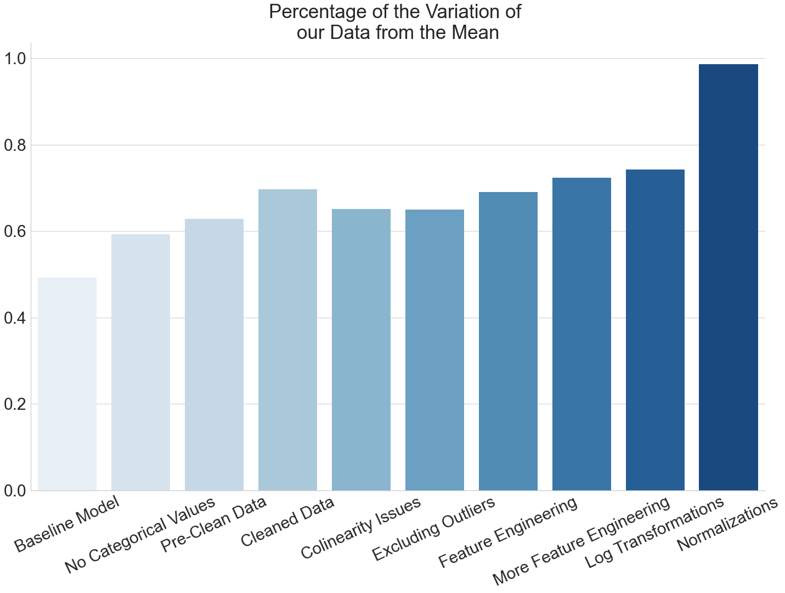
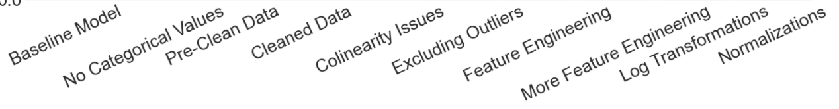

Models
Percentage of the Variation of our Data from the Mean
Several models were created in the analysis process
Notes:
We won’t go through the process of creating them in detail, but this is to give you an overall understanding of our progress.
This graph shows, in percentage, how much of the data our models were able to explain. So the more, the better.
There are a few things that the model have to take into account to be reliable though. One of them is the degree of correlation between features.

Slide 8
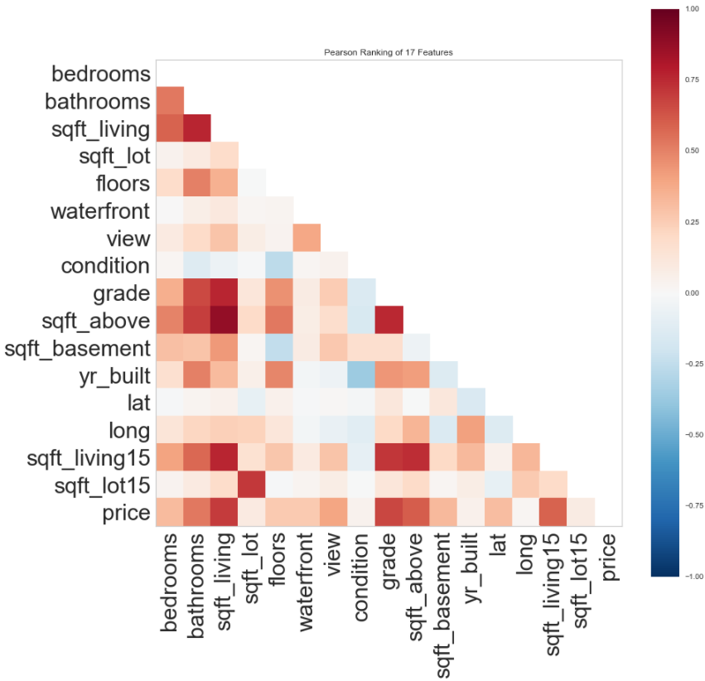
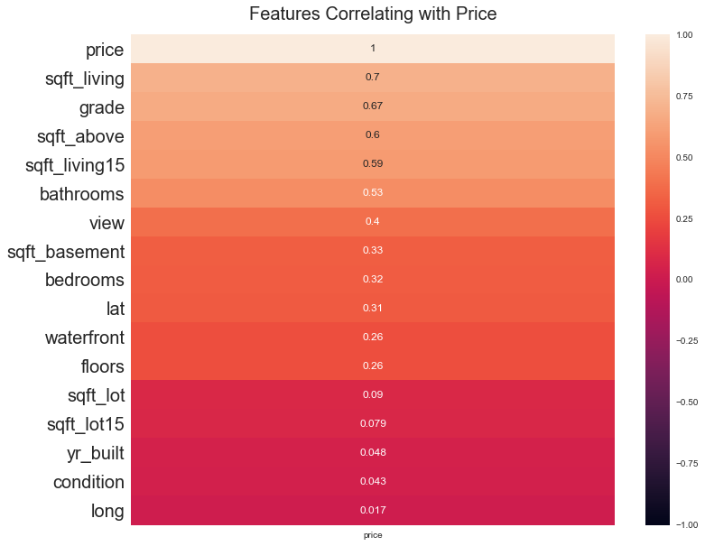
Correlation Degree Between Features
Multiple highly correlated features are not good for regression models
Correlation Between Features
Correlation of Features with Price
Notes:
Here you can see high collinear features as the most intensely red squares.
For instance, the amount of space above the basement is, unsurprisingly, highly correlated with the amount of living space.
In short, a lot of this data was not necessary for the model.

Slide 9
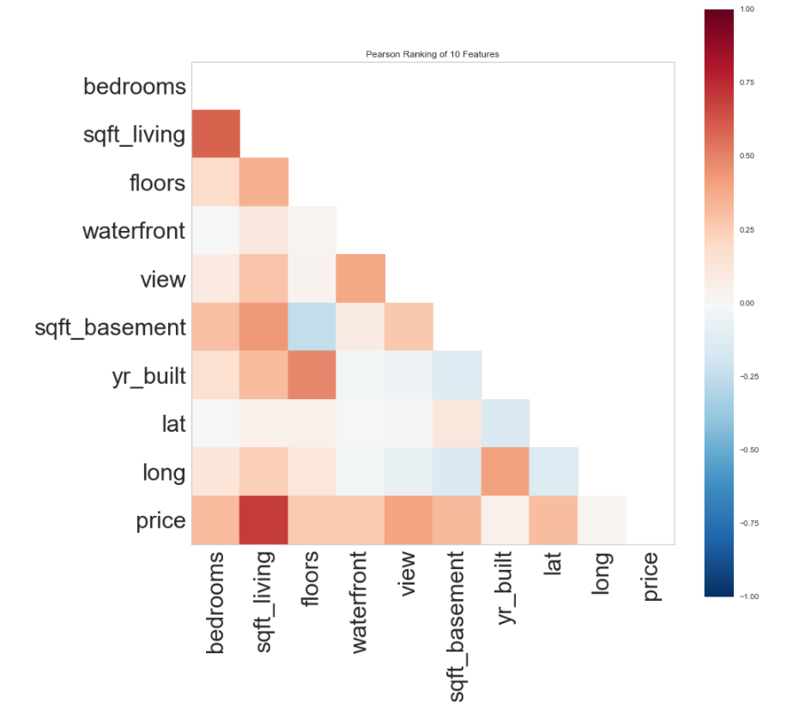
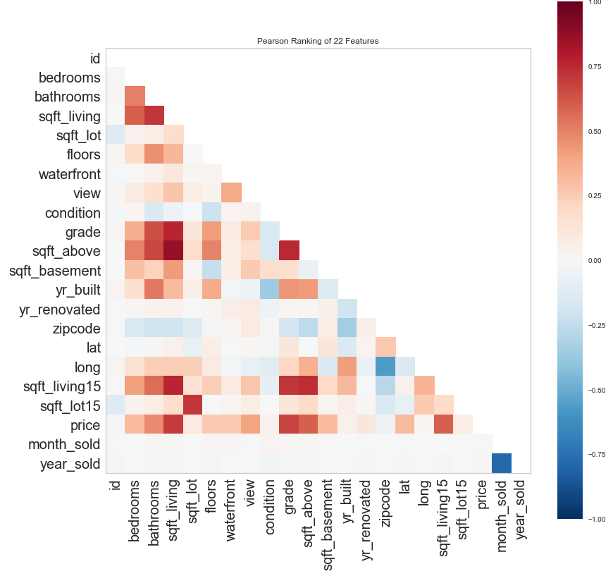
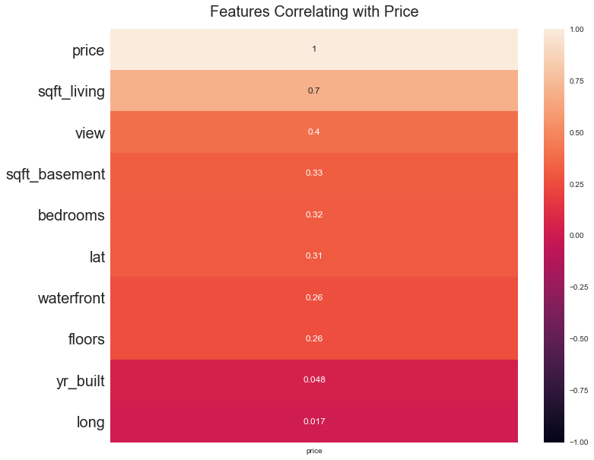
More appropriate
correlation matrix
Correlation Degree Between Features
Correlation Between Features
Correlation of Features with Price
Notes:
Here you can see high collinear features as the most intensely red squares.
For instance, the amount of space above the basement is, unsurprisingly, highly correlated with the amount of living space.
In short, a lot of this data was not necessary for the model.

Slide 10
Models
Percentage of the Variation of our Data from the Mean
Several models were created in the analysis process
Notes:
We won’t go through the process of creating them in detail, but this is to give you an overall understanding of our progress.
This graph shows, in percentage, how much of the data our models were able to explain. So the more, the better.
There are a few things that the model have to take into account to be reliable though. One of them is the degree of correlation between features.

Slide 11
Models
Percentage of the Variation of our Data from the Mean
100% Increase
Notes:
We won’t go through the process of creating them in detail, but this is to give you an overall understanding of our progress.
This graph shows, in percentage, how much of the data our models were able to explain. So the more, the better.
There are a few things that the model have to take into account to be reliable though. One of them is the degree of correlation between features.

Slide 12
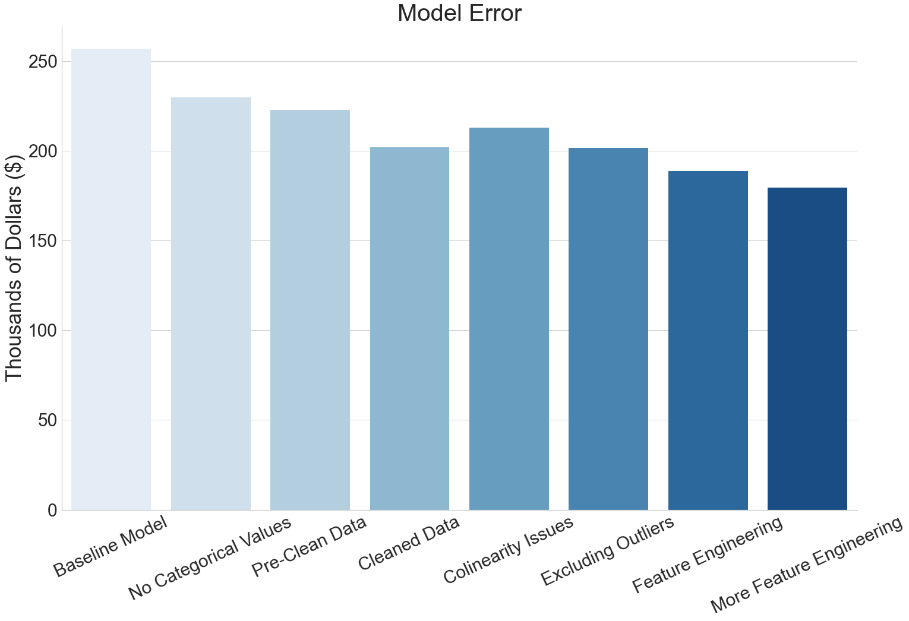
Models
Models
Model Error
30% Decrease
How much money a better model can save
Notes:
That is all dandy and all, but what does it means for you? Well, our latest model has a predictive error 5.15% lower than one made with all the initial information.
That means that, with less information, we can predict more accurately the fair price of a house, which could save Zillow 10 thousand dollars (that’s the decrease in the error) on each purchase they make.
With Zillow purchasing thousands of houses a month, this could save them millions of dollars per year.

Slide 13
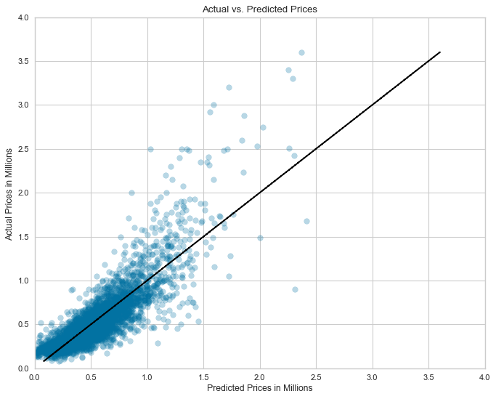
R-squared= 72.5%
RMSE = $178,958
Notes:
I’m here too =p

Slide 14
Notes:
I’m here too =p

Slide 15
Notes:
I’m here too =p

Slide 16
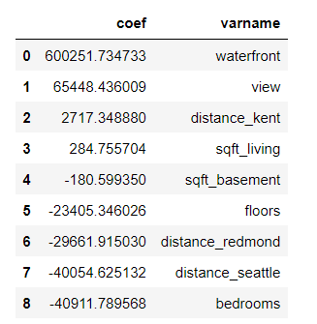
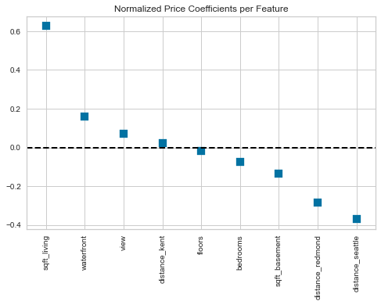
Coefficients
Notes:
We normalized the data to get a better idea of how each feature is impacting house price. Before normalizing, we see that if everything is held constant sqft_living has an increase of 285 dollars for every one square foot. However, after normalizing, it shows that sqft_living has the biggest impact on house prices. This passes the common sense test since we know that bigger homes cost more money. But aside from buying smaller homes, we wanted to look into the other features that also impact price.

Slide 17
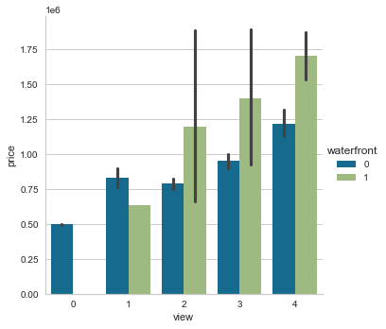
View and Waterfront vs Price
Homes with a higher view rating are also more likely to be a waterfront property.
Waterfront increase: $564,000-637,000
View per rating increase: $61,300-69,600
Notes:
Waterfront properties vary more pricewise in relation to the actual view, but tend to cost more in general.

Slide 18
View and Waterfront vs Price
Homes with a higher view rating are also more likely to be a waterfront property.
Waterfront increase: $564,000-637,000
View per rating increase: $61,300-69,600
Notes:
Waterfront properties sees an increase within this range from one without

Slide 19
View and Waterfront vs Price
Homes with a higher view rating are also more likely to be a waterfront property.
Waterfront increase: $564,000-637,000
View per rating increase: $61,300-69,600
Notes:
And view has an increase within this range per increase in view rating

Slide 20
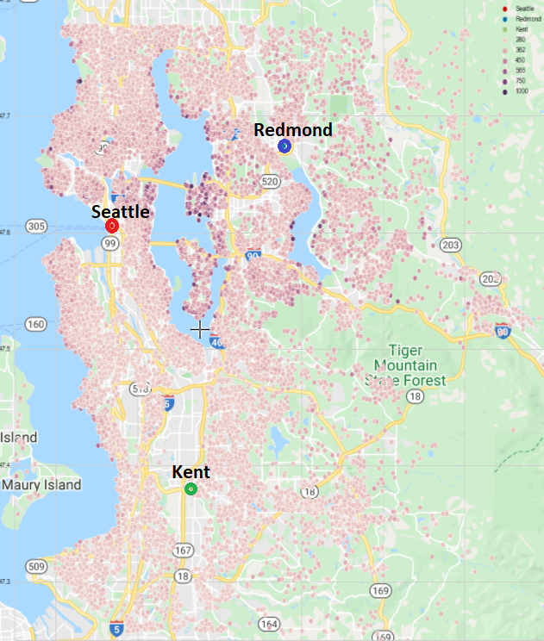
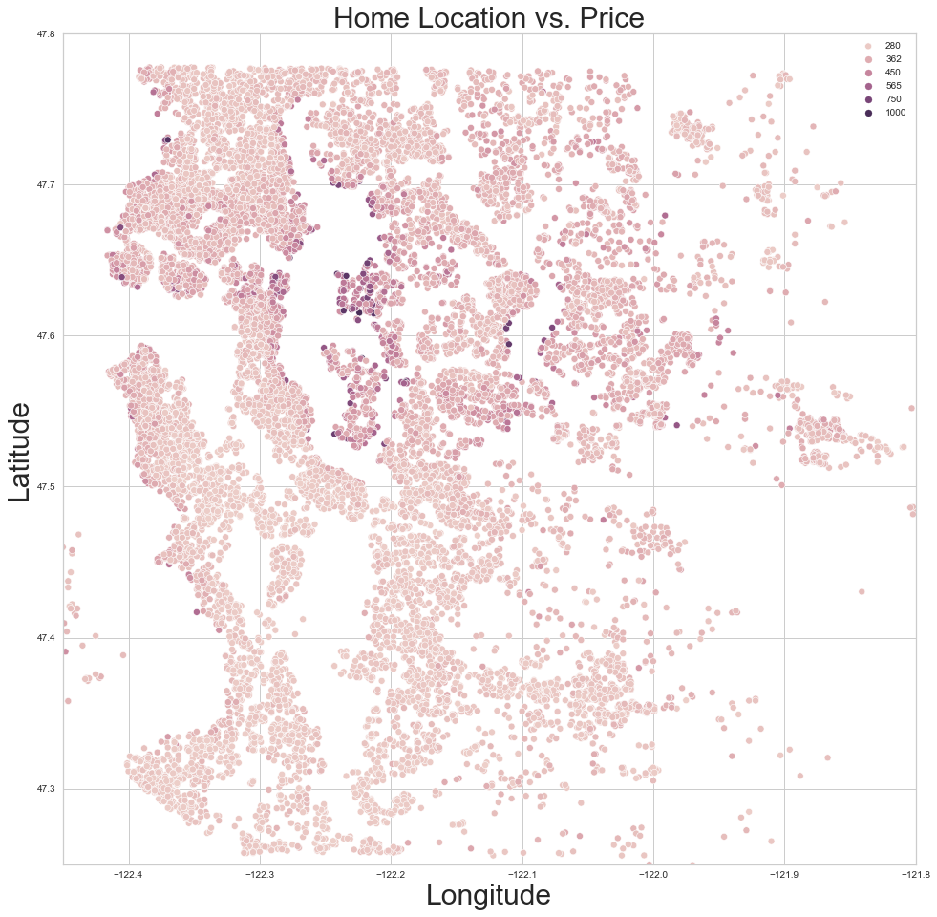
Location v Price
Higher priced houses around Lake Washington and Lake Sammamish
Distance from Kent increases: +$2,161 - 3,274
Distance from Seattle decreases: -$38,800 - 41,300
Distance from Redmond decreases: -$28,200 - 31,100
Notes:
Here, we have a map showing the more expensive houses as the more intense the color.
We notice a trend around Lake Washington and Lake Sammamish containing the majority of the most expensive houses.
Also, the house prices seem to decrease the further they are from Seattle and Redmond, and the closer they get to Kent with Kent having the cheaper homes overall.

Slide 21
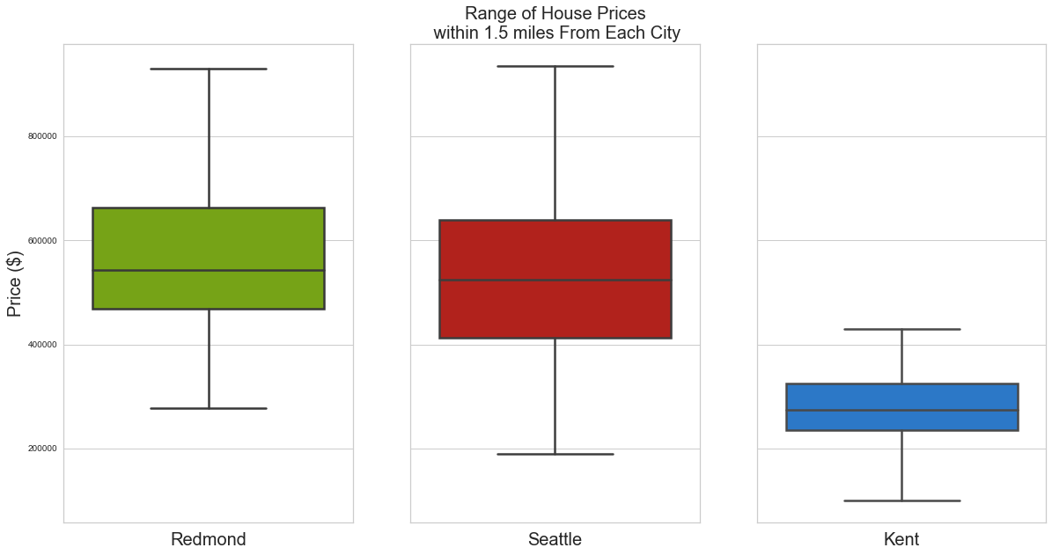
Location v Price
Range of prices close to city center
Notes:
To confirm this, we arranged the range of house prices within 1.5 miles from each city, and as you can see, the houses around Redmond and Seattle have a higher range of price than the ones around Kent.

Slide 22
Conclusions

Slide 23
Recommendations
Use our predictive model to help predict house prices
Avoid looking at expensive houses close to bodies of water and with great view
Look around Kent to find a higher number of cheaper houses

Slide 24
Next Steps
Find more features that home buyers often value highly to add to the model.
Correlate the information of this model with ones for other states.
Notes:
For instance, a Fireplace.
To find how much more or less profitable buying a house in on state can be in relation to another.

Slide 25

Thanks!
Any questions?
Find us at:
Hoang Nguyen
GitHub @DataDoggo215
hvnguyen90@gmail.com
Marcelo Scatena GitHub @moscatena
moscatena@gmail.com
Madoria Thomas
GitHub @madoriathomas
deaudrey011@hotmail.com

Slide 26
Credits
Special thanks to all the people who made and released these awesome resources for free:
Presentation template by SlidesCarnival and Google
Photographs by SeattleMet and King County
More info on how to use this template at slidescarnival.com/help-use-presentation-template
This template is free to use under Creative Commons Attribution license. You can keep the Credits slide or mention SlidesCarnival and other resources used in a slide footer.

